Slide 1

PSPJ PROJECT
Student Council Election Tally System
A Java-based console application to cast votes, tally results and declare the winner automatically

Slide 2



Abstract
The Student Council Election Tally System is a Java application that replaces slow, error-prone manual counting with an automated digital process.
The admin sets up the candidates, students cast their votes through a menu, and the system records each vote, counts invalid entries, and generates a result report.
The winner is declared from the highest vote count, and a tie is detected and reported instead of picking a wrong winner.
Fast
Results are ready the moment voting ends
Accurate
No manual counting mistakes
Transparent
Every vote and invalid entry is counted and shown

Slide 3





Introduction
Student council elections in colleges are often run with paper ballots or informal counting.
This project builds a menu-driven Java program that handles the full flow: voting, tallying and result declaration.
It applies core Java concepts (OOP, arrays, loops, conditions) to a real, relatable problem.
Set up candidates
Cast votes
Tally votes
Declare winner

Slide 4




Existing System
Manual elections using paper ballots or informal counting
Time-consuming
Prone to human error
Counting every paper ballot by hand takes hours
Miscounts and lost or damaged ballots change results
Open to manipulation
Lacks transparency
Informal counting can be tampered with
Voters cannot easily verify how the count was done

Slide 5



Proposed System
A Java console application that automates the whole election
Ballot menu
Vote recording
Invalid votes
Result and winner
Candidates are listed with numbers, plus an option to end voting
A valid choice adds one vote to that candidate
Wrong options are not lost, they are counted separately
Shows total votes, each count, then the winner or a tie

Slide 6
Keywords and Concepts Used
Keyword / Method | What it does in our project | Why we used it
class Election | Holds the candidates, votes and all voting logic | Models the real election as an object (OOP)
extends, super() | StudentCouncilElection inherits Election and passes the candidate names | Reuses code, so candidates can change without rewriting logic (inheritance)
Constructor | Election(String[] names) sets candidates and creates the votes array | Prepares a fresh election automatically when the object is created
String[ ] and int[ ] arrays | candidates[i] and votes[i] are linked by index | Simple storage: votes[i] always belongs to candidates[i]
Election e = new StudentCouncilElection() | Parent-type reference holds the child object | Polymorphism, so main() works with any type of election
public, void, int | Access level and return type of each method | Lets main() call the methods; int returns counts, void performs actions
Scanner (java.util) | Reads the voter’s menu choice from the keyboard | Takes live input from the user

Slide 7
Methods and Control Statements Used
Keyword / Method | What it does in our project | Why we used it
showMenu() | Prints the ballot menu using a for loop | Lists candidates dynamically, however many there are
castVote(choice) | if / else if / else on the choice | Valid: adds a vote. End option: closes voting. Anything else: invalid vote
getEndOption() | Returns candidates.length + 1 | End option adjusts automatically to the number of candidates
getValidVotes(), getTotalVotes() | Enhanced for loop adds up the votes | Gives total valid votes and total votes cast
declareWinner() | Loop with maxVotes and a boolean isTie | Finds the highest count, detects a tie, handles zero votes
showResults() | Prints totals and each candidate’s count | Displays the final tally, then calls declareWinner()
do-while loop in main() | Repeats the menu until the end option is chosen | Runs at least once and keeps voting open until closed

Slide 8
CO Attainments
CO1
Applied core Java syntax: variables, data types, operators, and input/output using Scanner
CO2
Used control statements and loops (if-else, for, do-while) to build the voting flow
CO3
Used arrays to store and process candidate and vote data, and built a working console application
CO4
Designed classes, constructors, methods and inheritance to model the election (OOP)

Slide 9
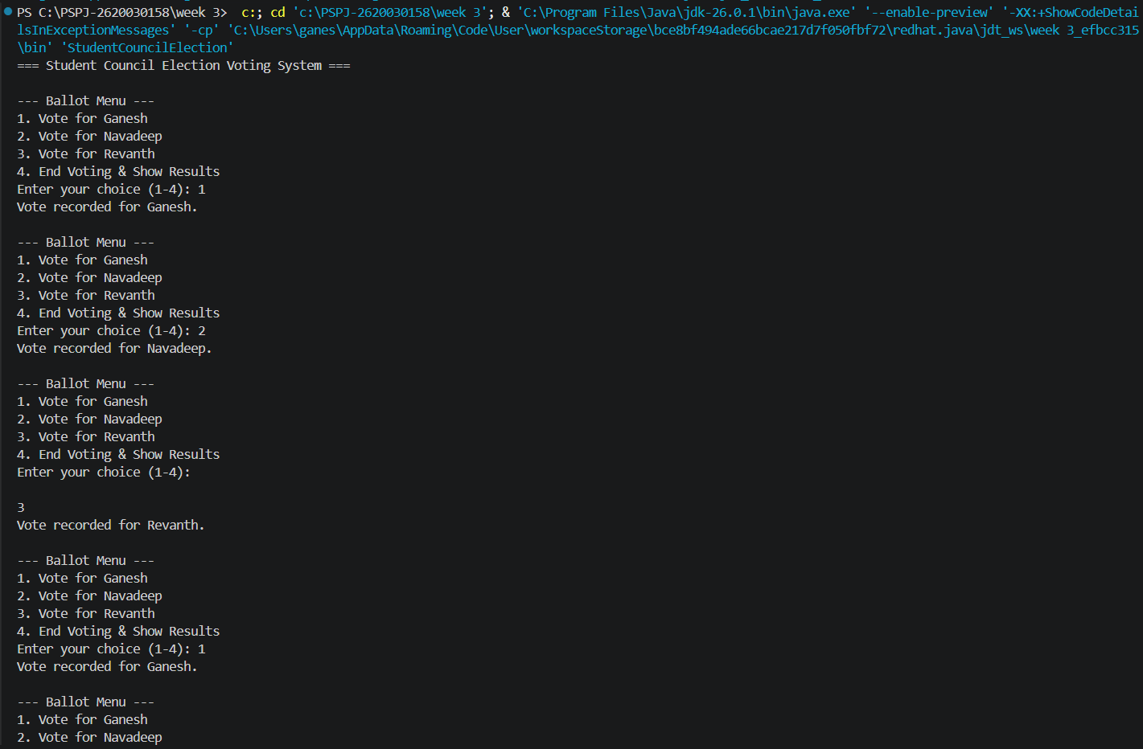
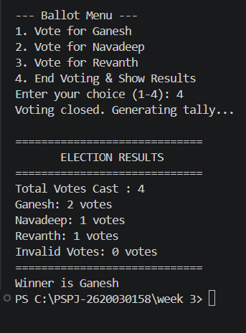
Result Screenshots
Voting menu and vote recording
Final tally and winner

